Slide 1
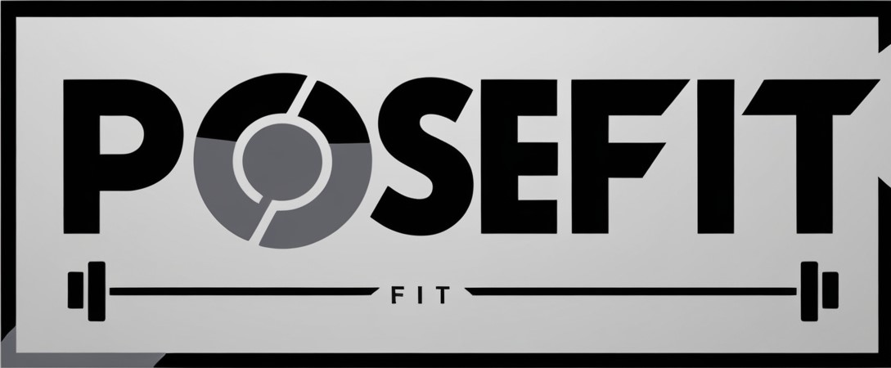
Real-Time Posture Detection and Correction
Presented By- Sumit Katwate Om Ladole Government College of Engineering Amravati

Slide 2
AIM and Objectives:
Aim:
To develop a real-time fitness monitoring system that accurately detects exercise posture and counts repetitions for various workouts.
Objectives:
Real-Time Pose Detection.
Reduce Injuries.
Posture Validation and Feedback.
Customize Selection (Exercize by choice).

Slide 3
Introduction
Develop a real-time exercise monitoring system using computer vision, MediaPipe and numpy.
Analyzes joint positions and angles to assess posture, detect movements, and count repetitions with high accuracy.
Provide an affordable, efficient solution for users to enhance exercise performance without the need for specialized equipment or professional trainers.

Slide 4





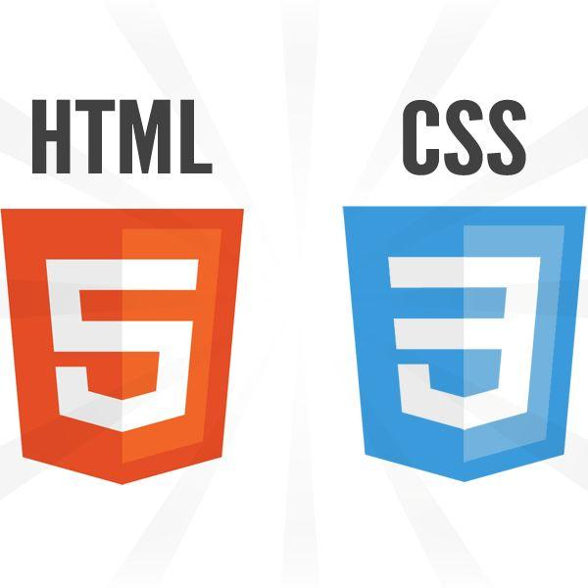
Technology Stack

Slide 5
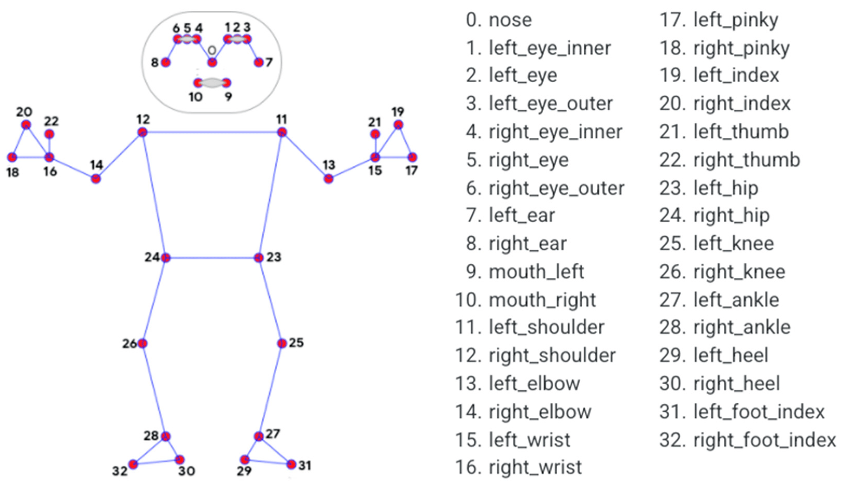
MediaPipe
MediaPipe is central to the pose detection in this project.
It provides real-time pipeline for detecting and tracking human poses from the video frames captured by OpenCV.
MediaPipe provides a pre-trained pose detection model that can identify and track 33 key points on the human body.

Slide 6
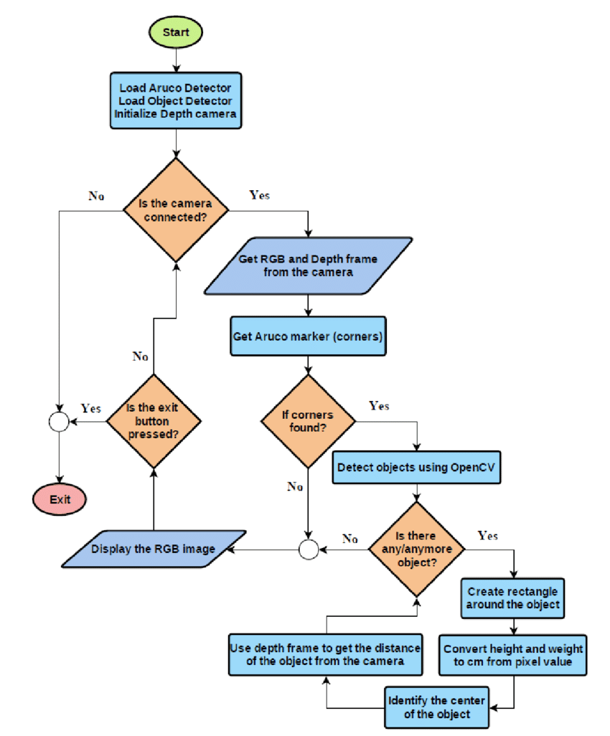
OpenCV
A powerful library for computer vision and image processing.
Detects edges, corners enabling object recognition and image matching.
Works efficiently with NumPy for array operations and MediaPipe for pose and hand tracking.

Slide 7
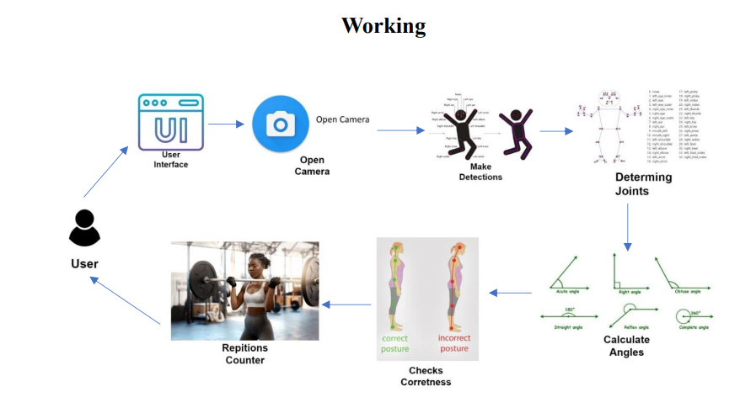

Slide 8
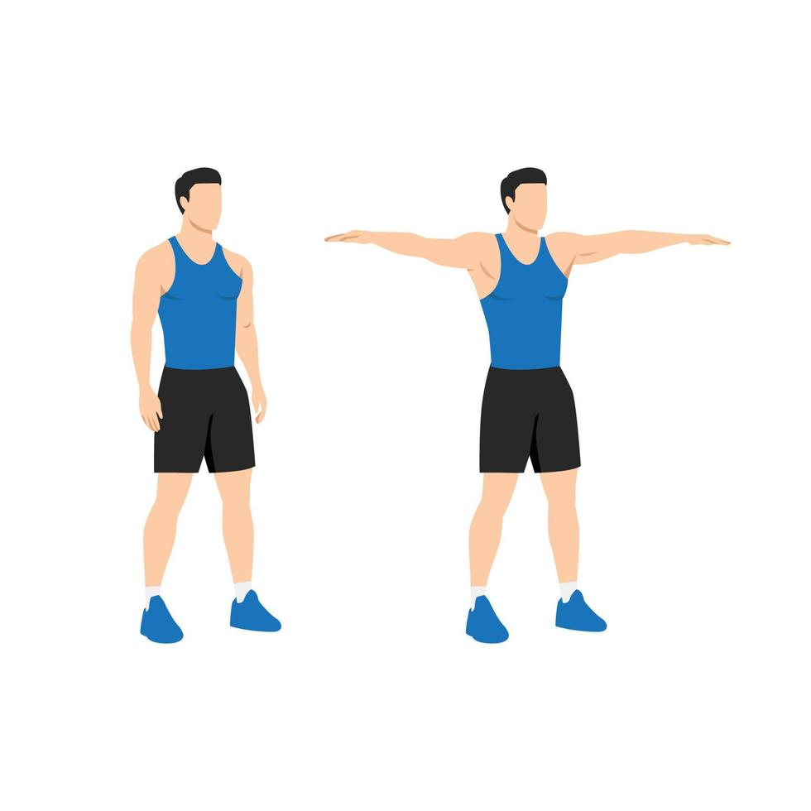
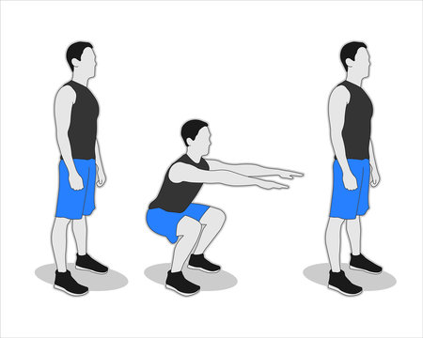
Empowering Fitness Through Computer Vision
Unleash your strength for powerful arms with the ultimate bicep curl workout for a muscular body !
Elevate your physique and define your style with side arm raises for strong, attractive shoulders!
Master the perfect squat form and unlock your full potential for stronger legs and a toned physique!

Slide 9
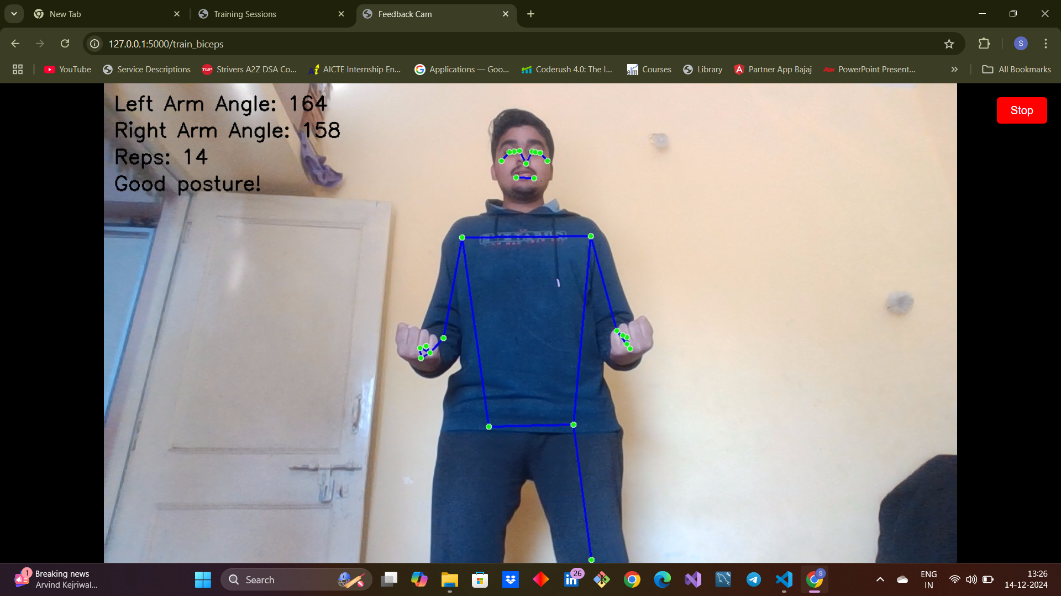
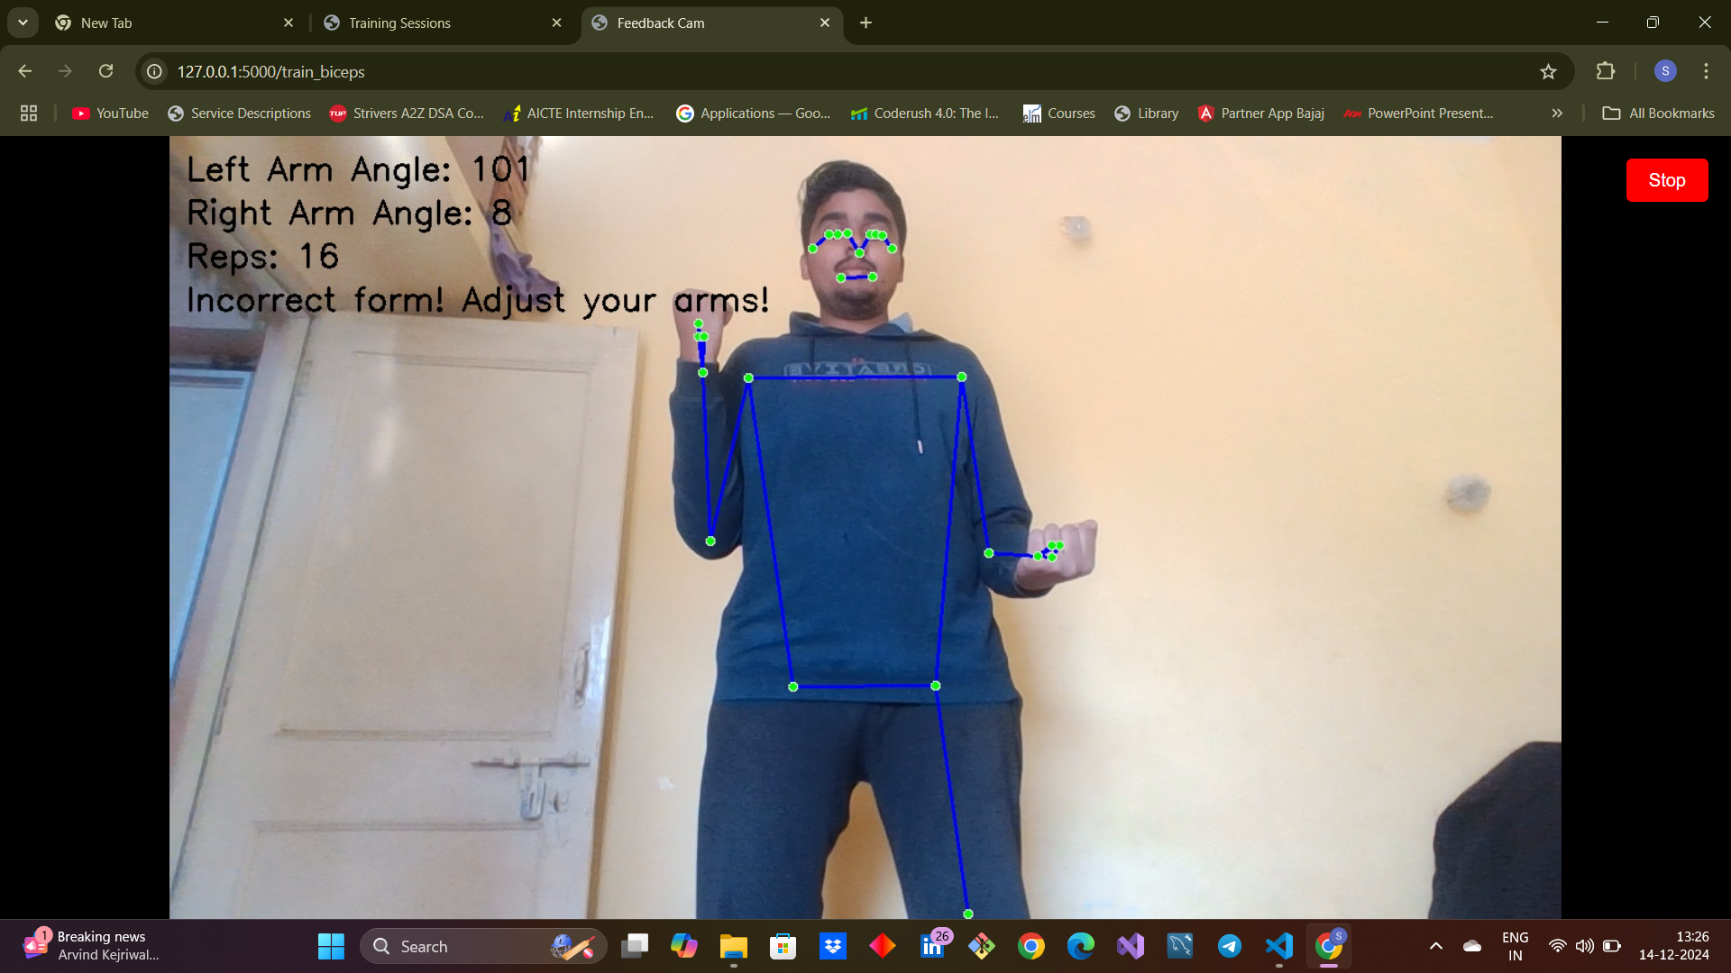
Test Cases - Biceps
Correct posture
Incorrect posture

Slide 10
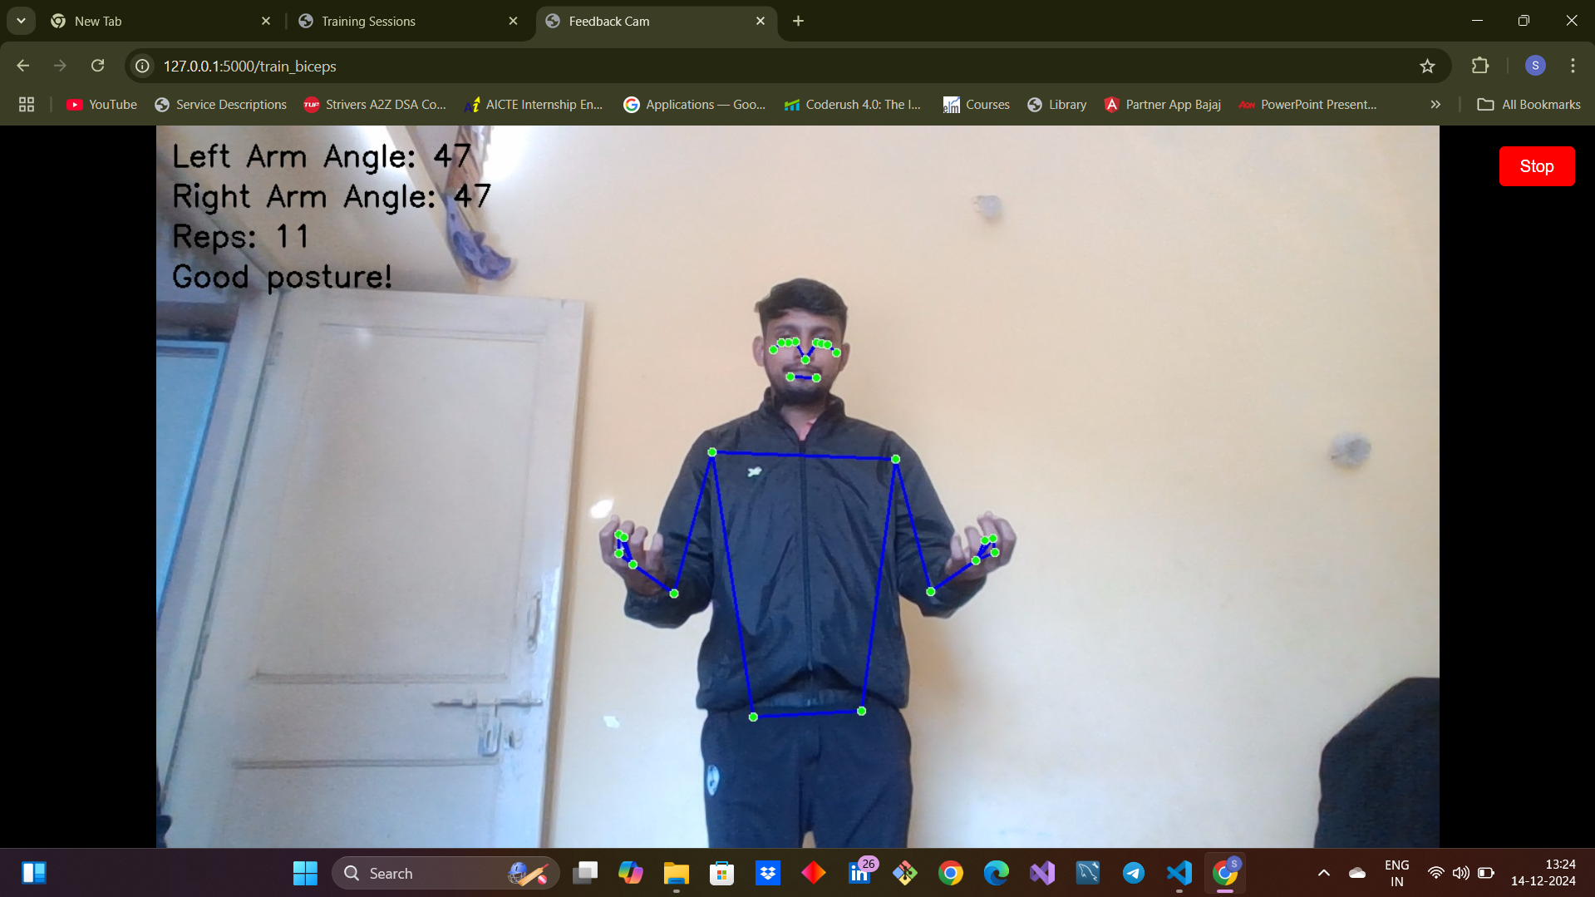
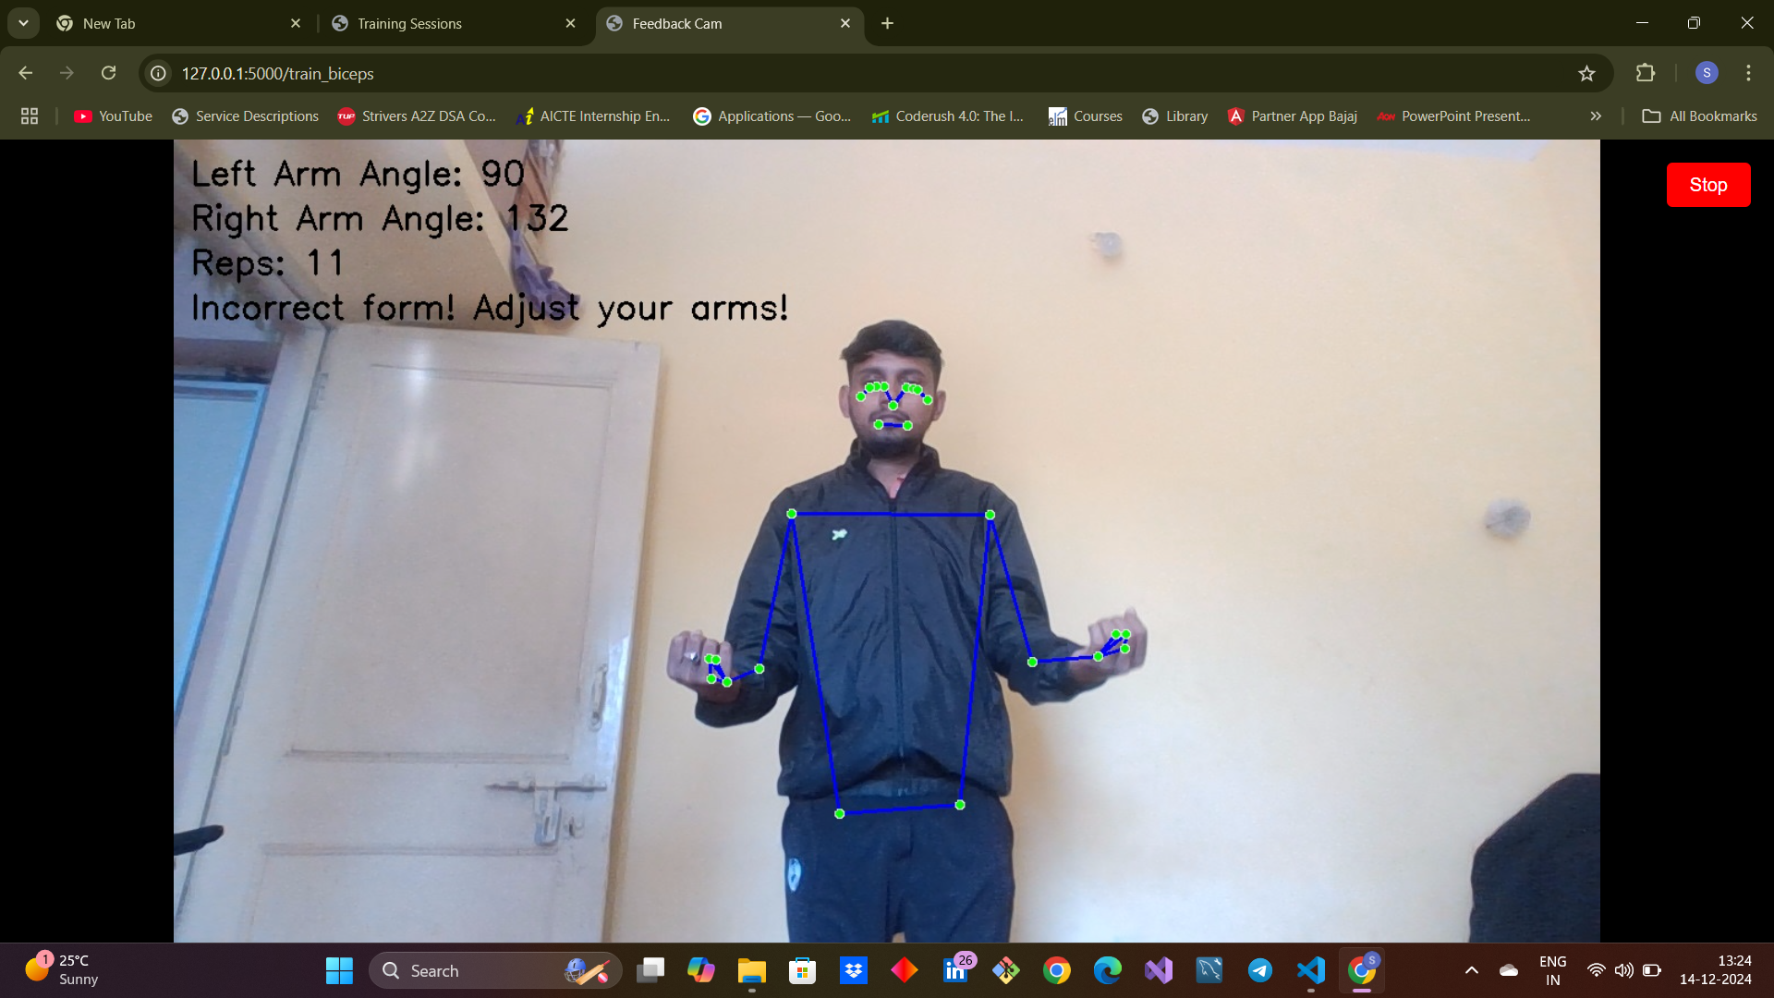
Test Cases - Biceps
Correct posture
Incorrect posture

Slide 11
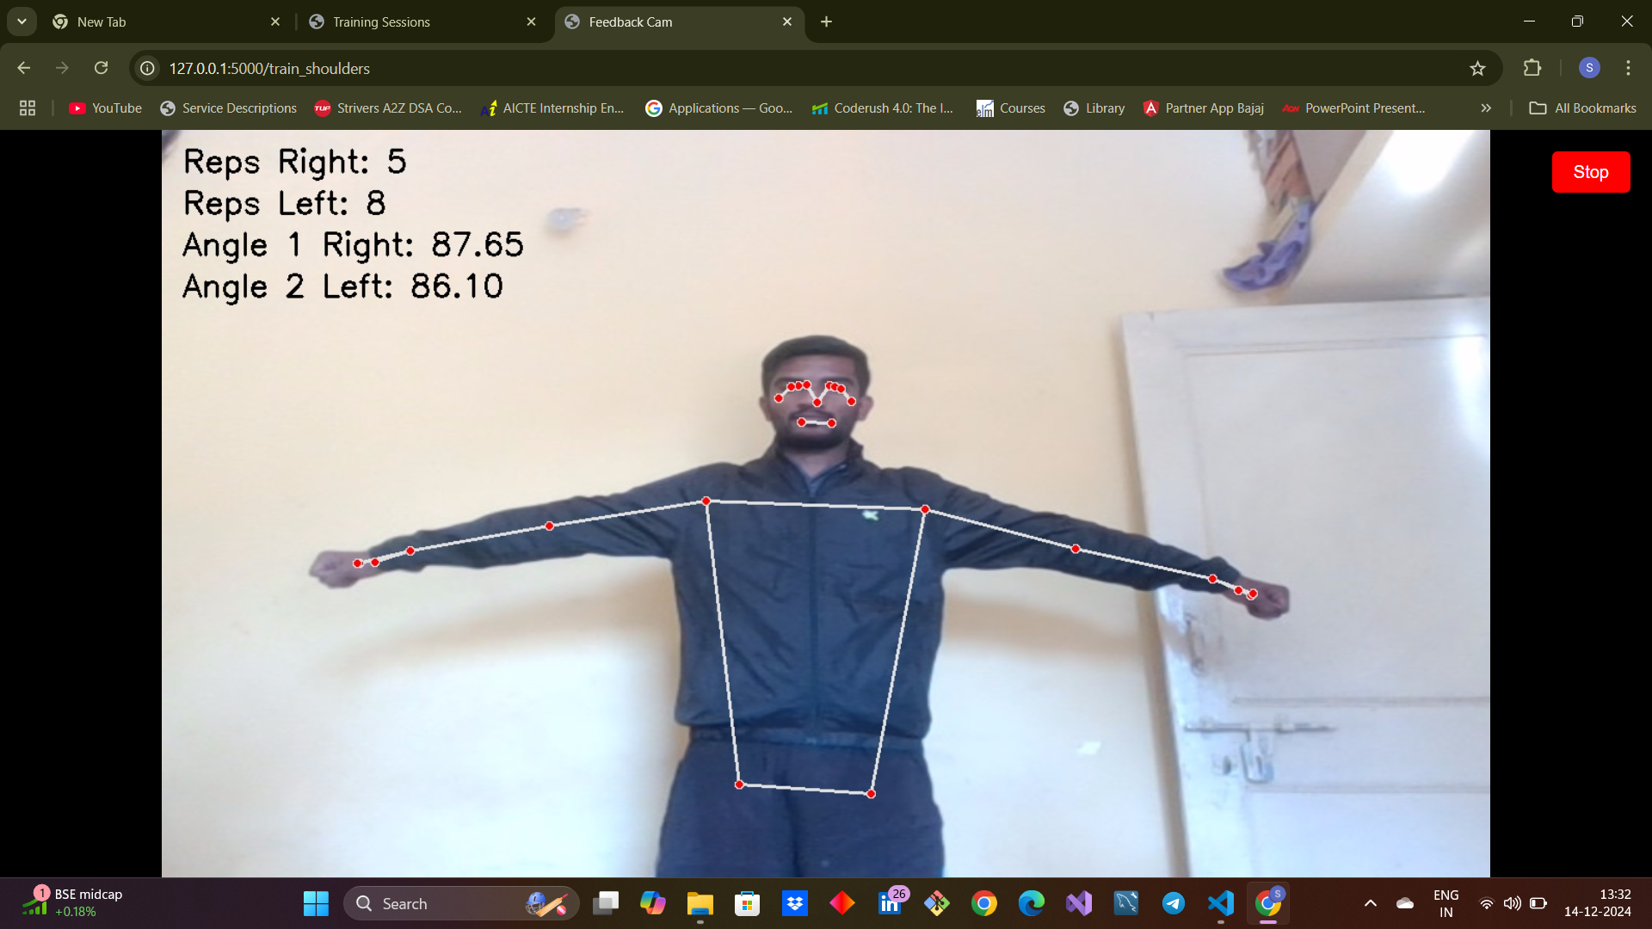
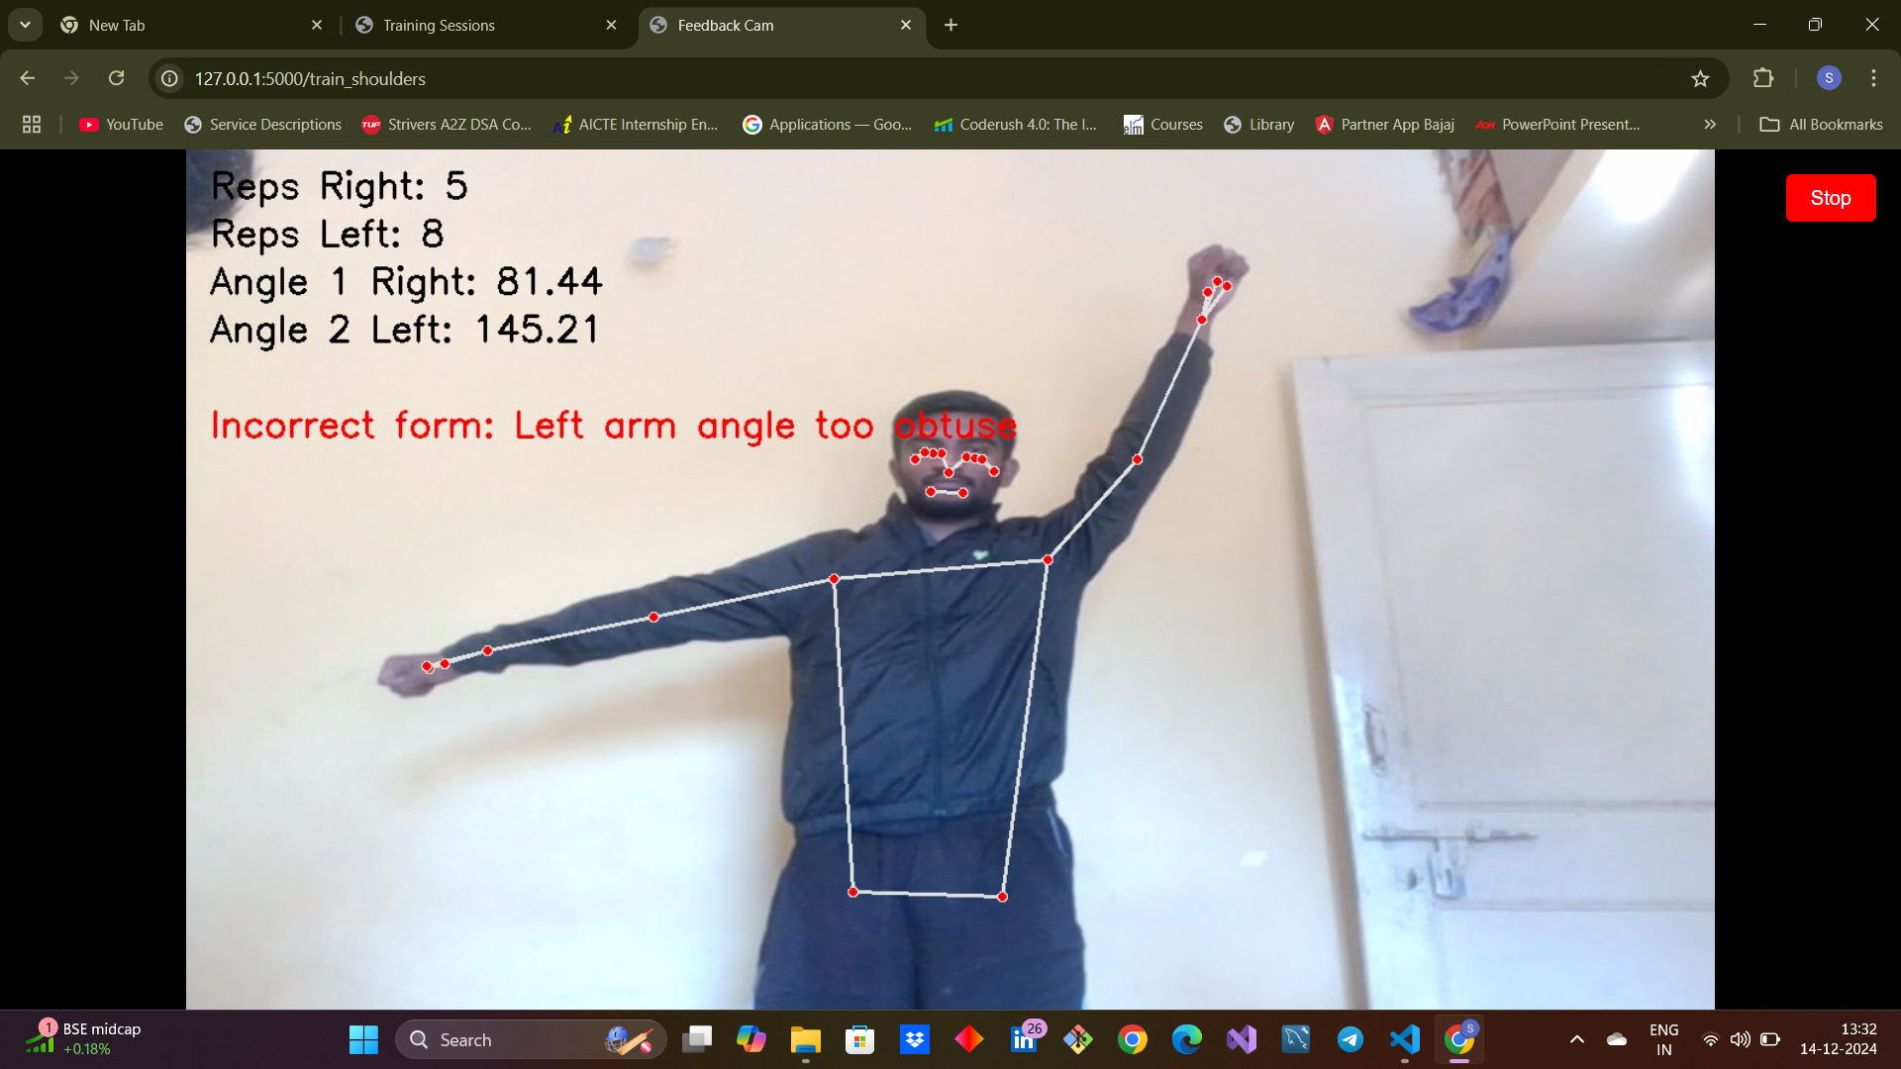
Test Cases - Biceps
Correct posture
Incorrect posture

Slide 12
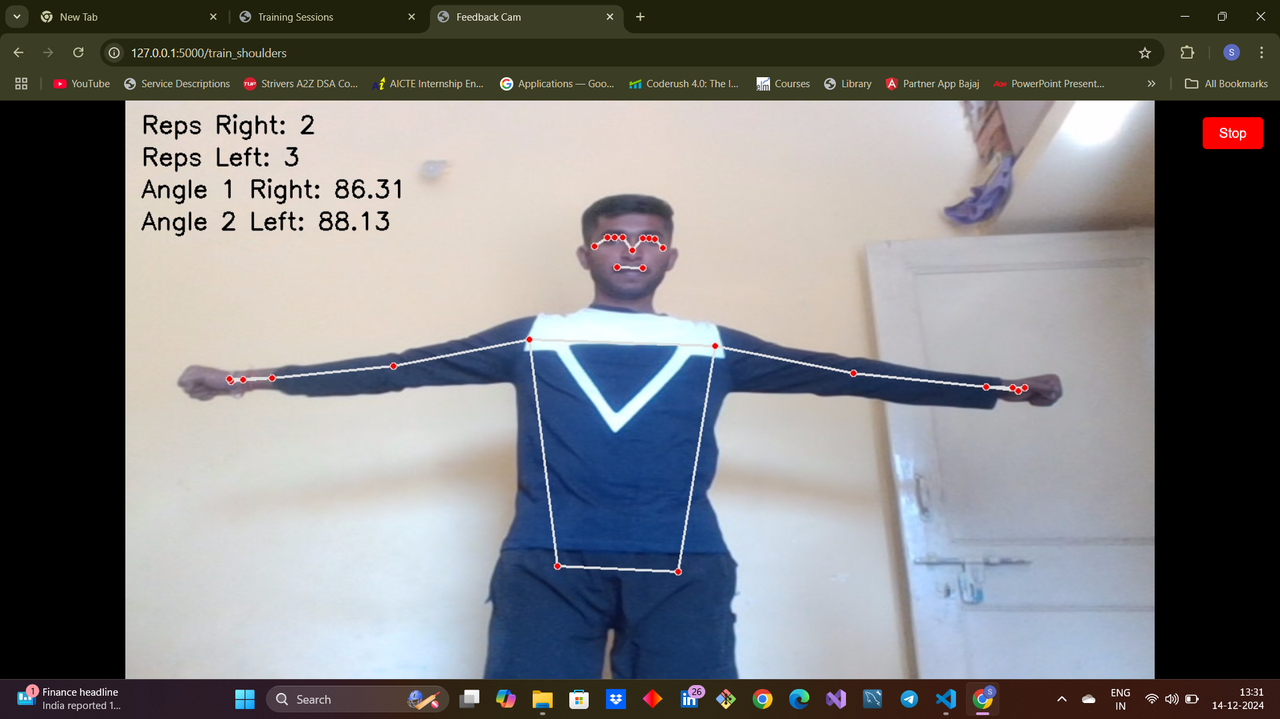
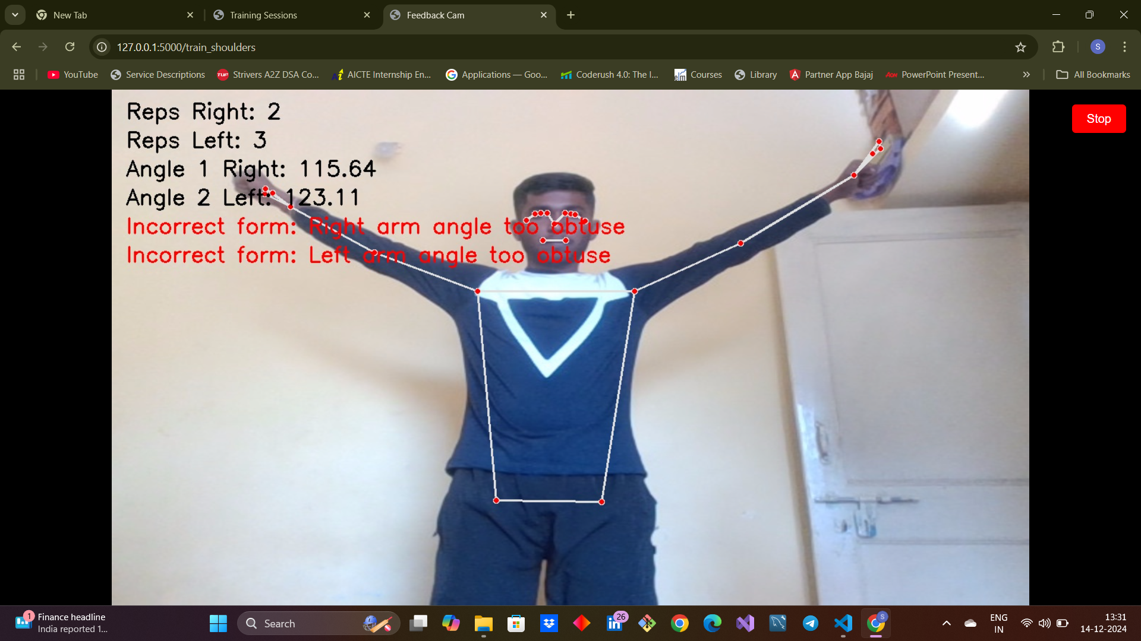
Test Cases – Shoulders(Double Handed)
Correct posture
Incorrect posture

Slide 13
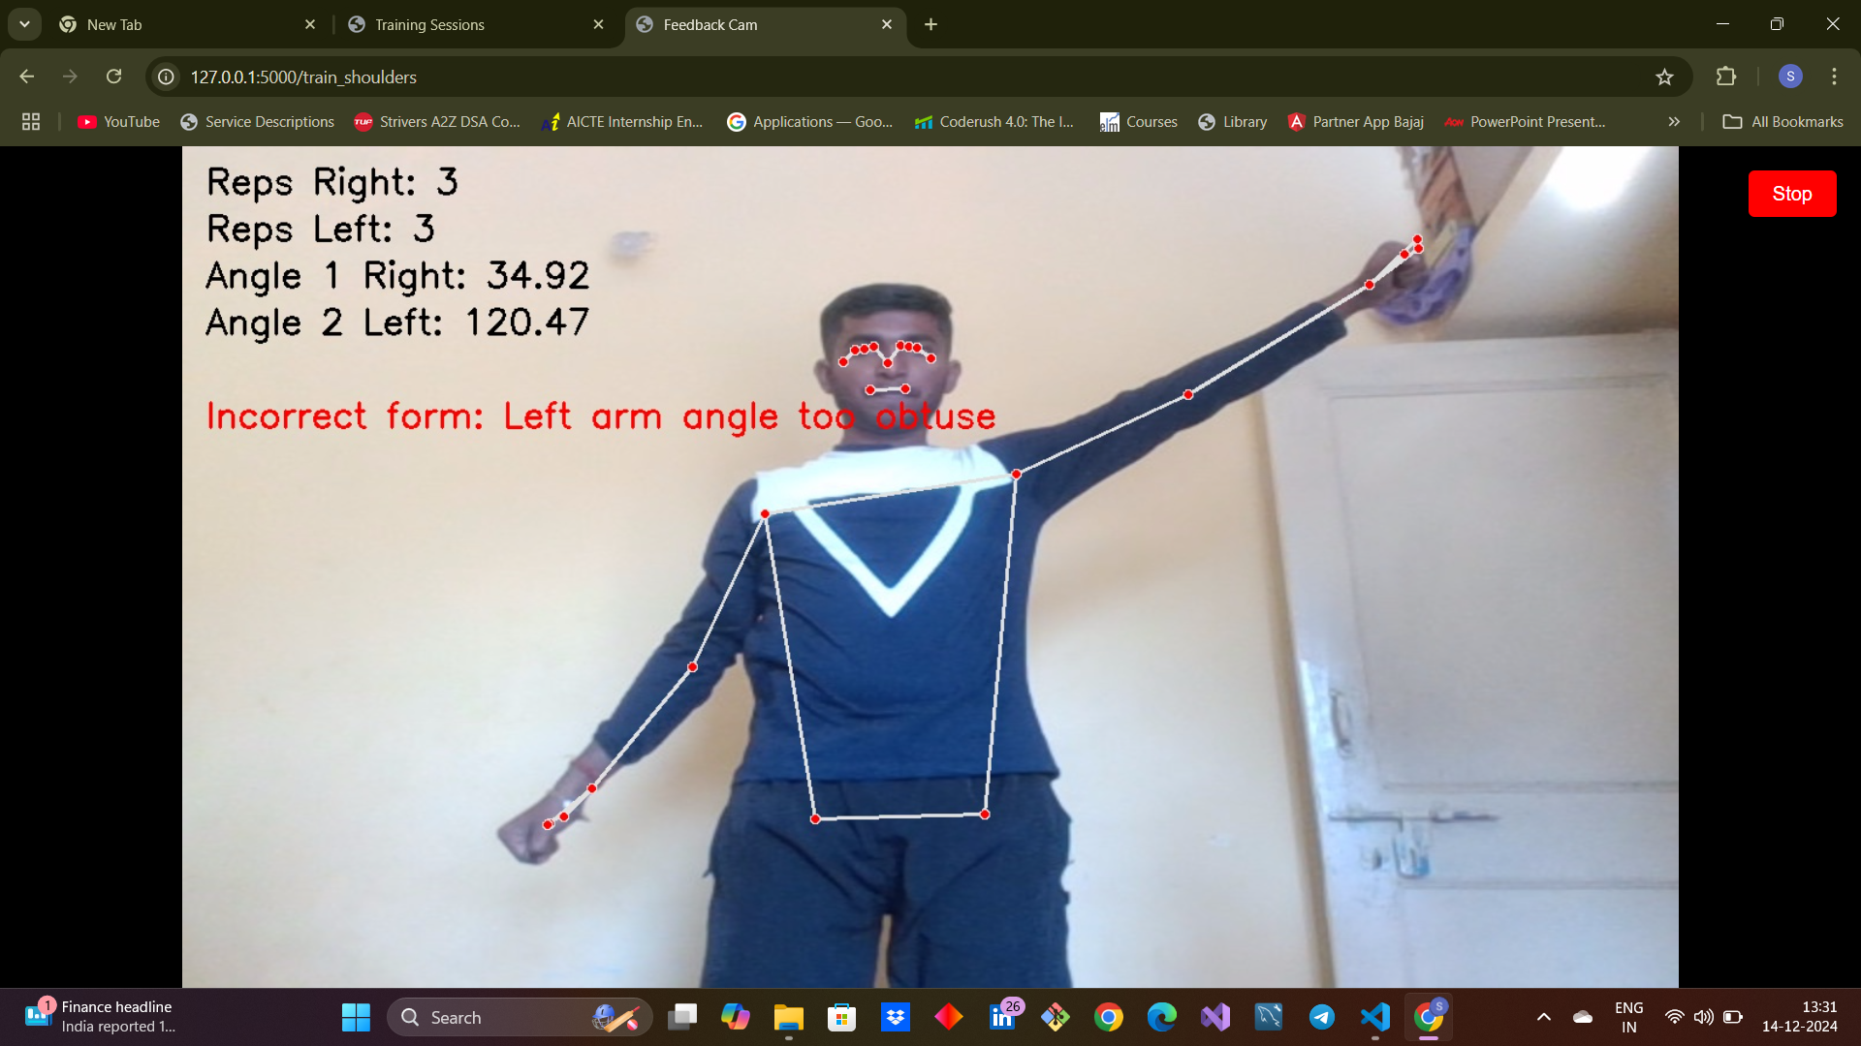
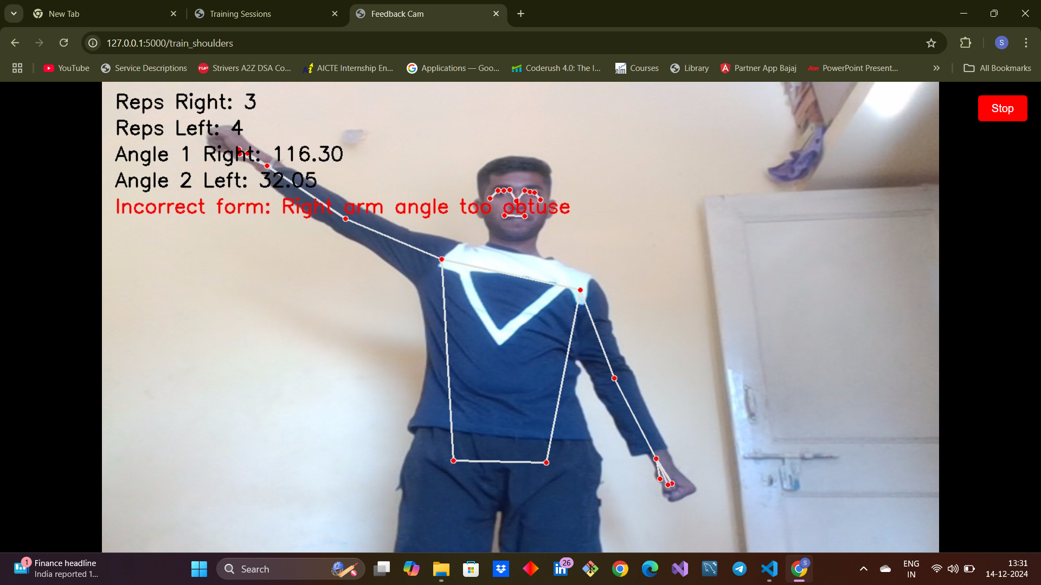
Test Cases – Shoulders (Single Handed)
Correct Posture
Correct Posture

Slide 14
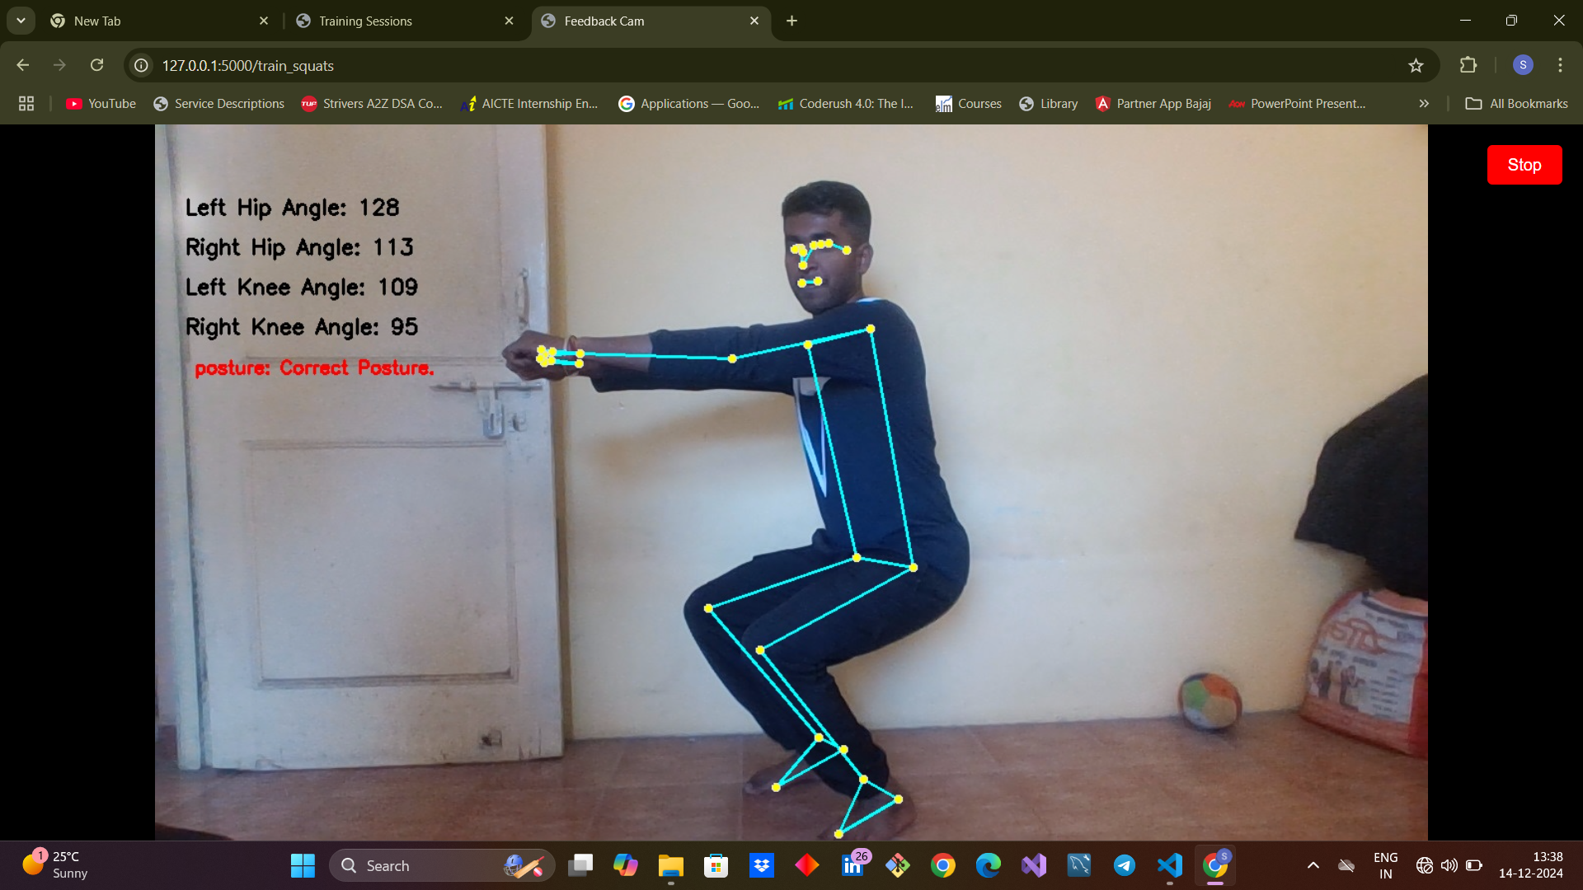
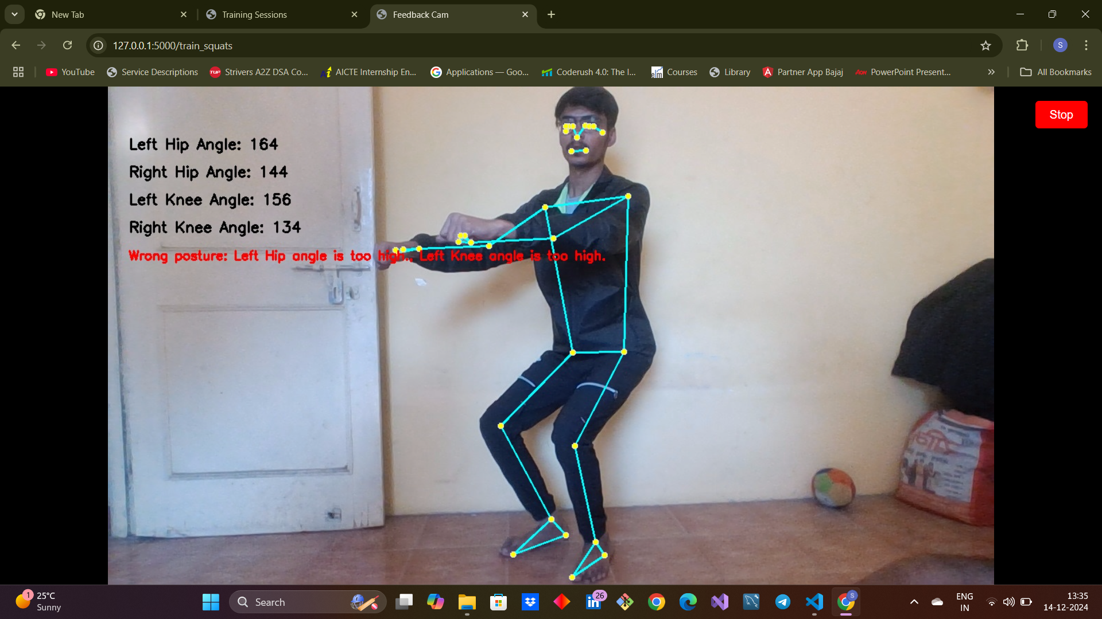
Test Cases - Squats
Correct posture
Incorrect posture

Slide 15





PoseFit's Key Features
Real-Time Feedback
Exercise Support
PoseFit delivers instant posture corrections, helping users improve their form in real time.
PoseFit currently supports key gym exercises, expanding its functionality to other workout types in the future.
Engaging Interface
Future Potential
The system features a user-friendly interface with clear visual feedback, enhancing user engagement and understanding.
PoseFit has the potential to integrate with AR/VR for immersive training experiences, further enhancing its capabilities.

Slide 16
Results
Accuracy
Engagement
Improvement
This model leverages high level of precision ensures that users receive correct and actionable insights, enabling them to maintain proper form throughout their workouts it supports users in achieving their fitness goals with confidence and efficiency.
User feedback indicates high levels of engagement, with users finding the visual feedback clear and actionable also it helps in providing personalized feedback, ensuring each user’s posture is assessed with precision.
Users have reported a significant improvement in their adherence to correct exercise form also contributes to greater safety by helping individuals avoid improper techniques that could lead to injuries.

Slide 17




Future Scope
1
Expansion & Integration
2
Fitness Tracking & Performance Analysis
3
Physical Thearpy & Soldier Performance
4
Deployment

Slide 18
Thank You
Thank you for your time. We believe PoseFit has the potential to revolutionize fitness by empowering individuals with accurate and personalized guidance.

